Slide 1
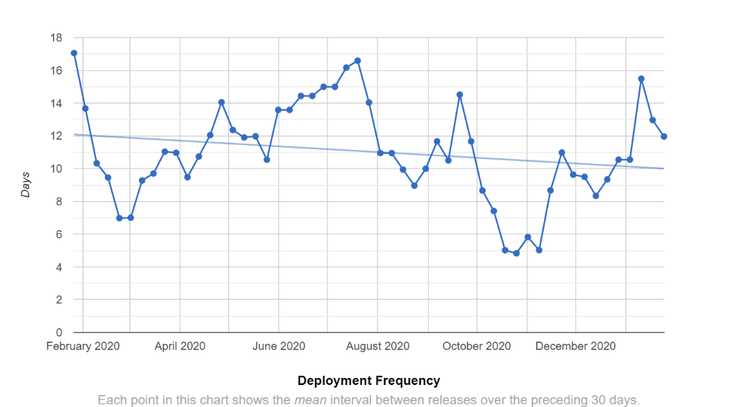
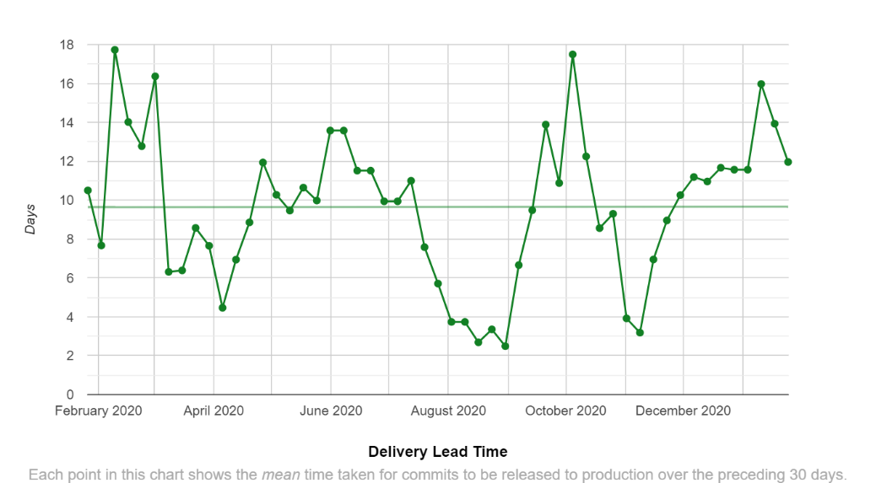
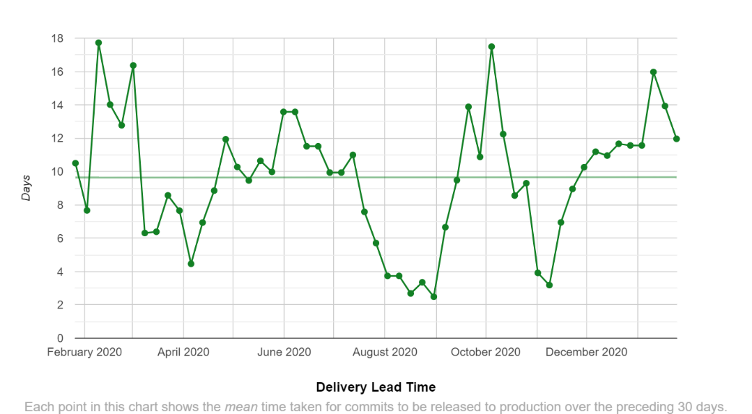
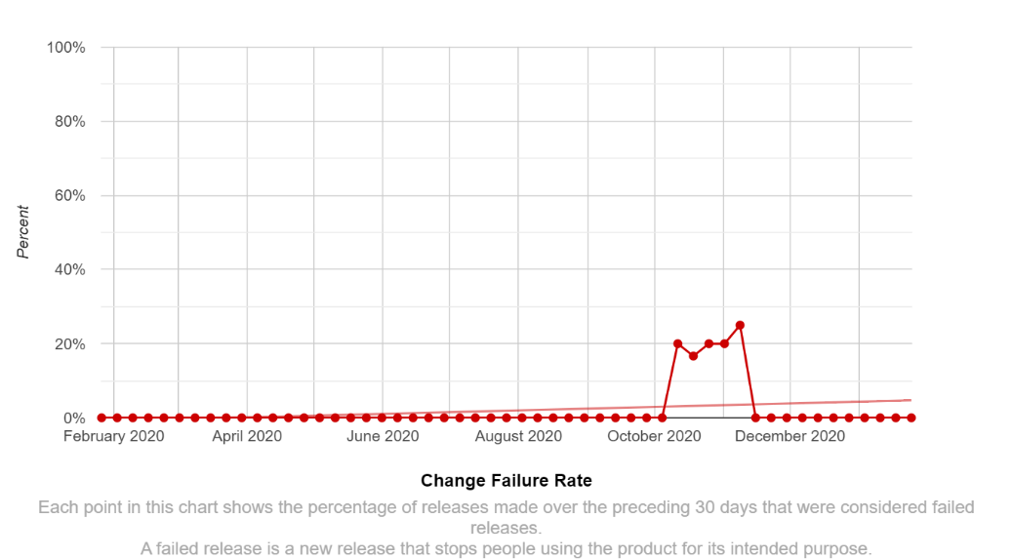
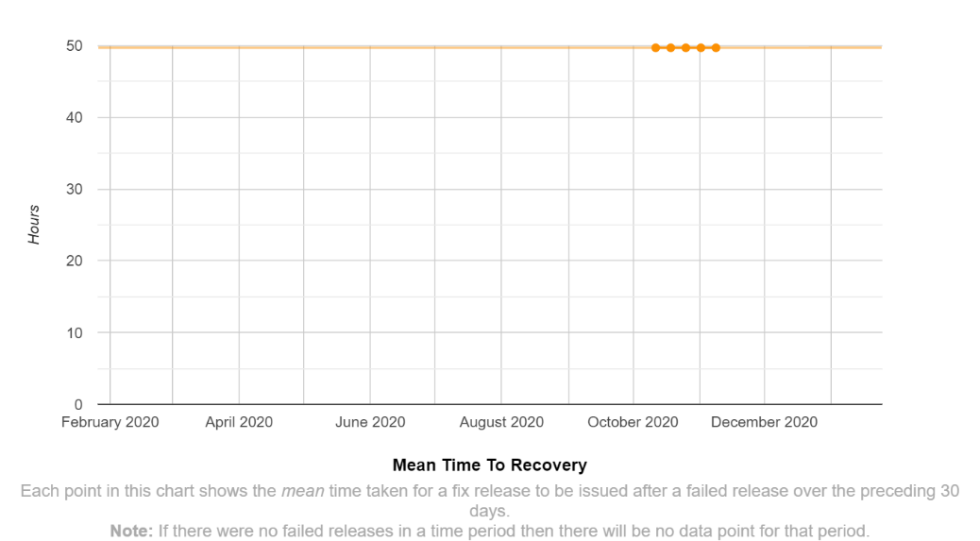
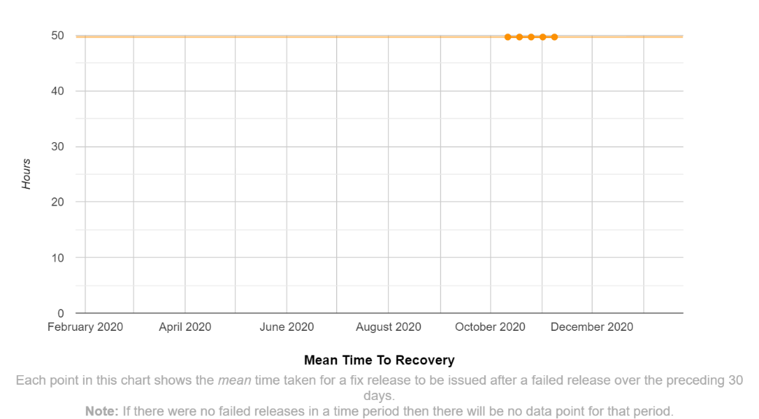
Software Delivery Performance

Slide 2

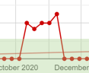
Software Delivery Performance
Notes:
FALSE POSITIVE
- LESS FREQUENT, AND NON REGULAR, RELEASES (~7 DAYS) DOESN’T COMPLIMENT A SLIDING FIXED 30 DAY WINDOW
CANT IMPROVE MTTR WITH A FAIL – DOES IT MAKE SENSE TO BE A TIME SERIES – SHOULD IT BE INCIDENT ACROSS THE X-AXIS

Slide 3
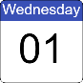
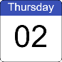
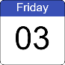
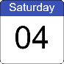
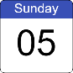
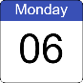
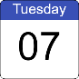
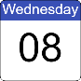
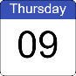
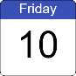
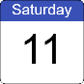
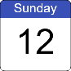
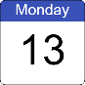
Change Fail Rate - Hypothesis
13 DAYS

Slide 4
Change Fail Rate - Hypothesis
13 DAYS
10 DEPLOYMENTS
10 SUCCESSFUL
0
FAILURES

Slide 5
Change Fail Rate - Hypothesis
0%
13 DAYS
10 DEPLOYMENTS
13 DAY CALC WINDOW
CHANGE FAIL RATE = 0%
10 SUCCESSFUL
0
FAILURES

Slide 6
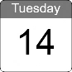
Change Fail Rate - Hypothesis
20%
13 DAYS
10 DEPLOYMENTS
13 DAY CALC WINDOW
CHANGE FAIL RATE = 20%
8 SUCCESSFUL
2
FAILURES

Slide 7

Change Fail Rate - Hypothesis
A DEPLOMENT HAS DROPPED OUT OF THE CALCULATION WINDOW
THE CHANGE FAIL RATE INCREASES WITHOUT A DEPLOYMENT HAPPENING
22%
14 DAYS
9 DEPLOYMENTS
13 DAY CALC WINDOW
CHANGE FAIL RATE = 22%
7 SUCCESSFUL
2
FAILURES
Notes:
Number of deployments in the window goes down!
Number of successful deployments goes down!
Change Fail Rate increases! - could equally go down if the omitted deployment was unsuccessful
We should omit the TIME WINDOW and rely of deployment frequency to maintain tension

Slide 8
Change Fail Rate - Hypothesis
A DEPLOMENT HAS DROPPED OUT OF THE CALCULATION WINDOW
THE CHANGE FAIL RATE INCREASES WITHOUT A DEPLOYMENT HAPPENING
22%
14 DAYS
9 DEPLOYMENTS
13 DAY CALC WINDOW
CHANGE FAIL RATE = 22%
7 SUCCESSFUL
2
FAILURES
Notes:
Number of deployments in the window goes down!
Number of successful deployments goes down!
Change Fail Rate increases! - could equally go down if the omitted deployment was unsuccessful
We should omit the TIME WINDOW and rely of deployment frequency to maintain tension

Slide 9
Change Fail Rate - Hypothesis
A DEPLOMENT HAS DROPPED OUT OF THE CALCULATION WINDOW
THE CHANGE FAIL RATE CHANGES WITHOUT A DEPLOYMENT HAPPENING
22%
REMOVE THE TIME WINDOW
CALCULATE THE RATIO/PERCENTAGE ACROSS DEPLOYMENTS ONLY
USE THE OTHER METRICS TO MAINTAIN TENSION
Notes:
Number of deployments in the window goes down!
Number of successful deployments goes down!
Change Fail Rate increases! - could equally go down if the omitted deployment was unsuccessful
We should omit the TIME WINDOW and rely of deployment frequency to maintain tension

